Slide 1
ME AND MYSELF
So yahh buckel up for my journey

Slide 2
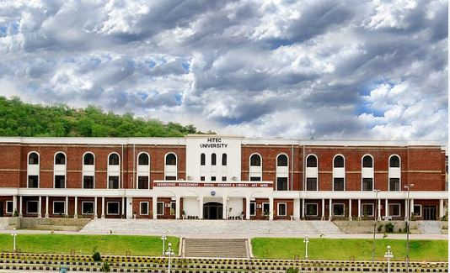
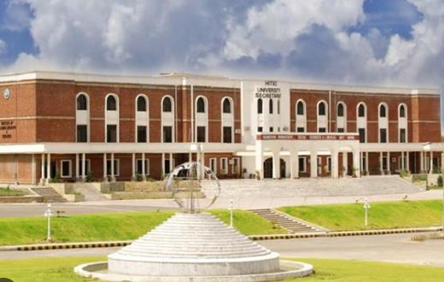
MY CNIC KIND OF DETAILS
~ Name = Omamah khan
.~ Back ground
Fsc & matric from HITEC

Slide 3
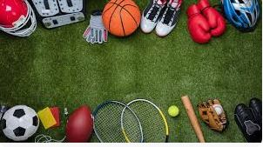

What am I good in ??
SPORTS :
.
My achievements in sports :
2nd position in Cricket
1st position in NETBALL
1st position in BADMINTON in
2nd position again in NETBALL.
Played Net ball at Federal level

Slide 4
Skills
MY skills are ad follows
Fast learner
Good in coding
Being Updated
Leadership
FAST TYPING
No hesitation while presenting or communicating .
Good in exchanging knowledge ,and helping my team

Slide 5
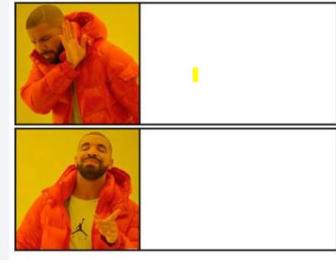
Hobbies
Learning new Language .
E learning (Coursera ,Google courses )
eating
Sleeping
Watching Netflix
Creating games
Clearly not reading or painting
Playing games
Creating games

Slide 6


GOALS
Dream of sailing through sky and landing among stars .
GOAT Coder
Work in GOOGLE , AMAZON
Travel round the world
Meet new people

